Slide 1
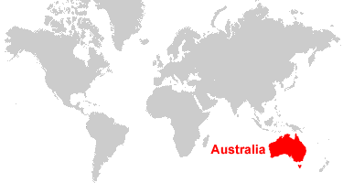


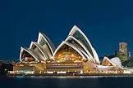
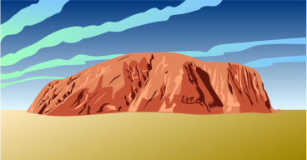
Australia

Slide 2
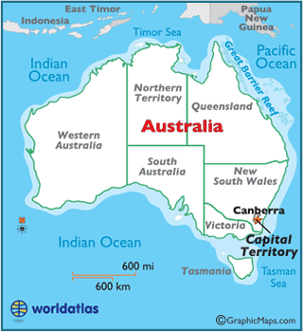
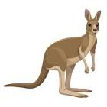


Slide 3
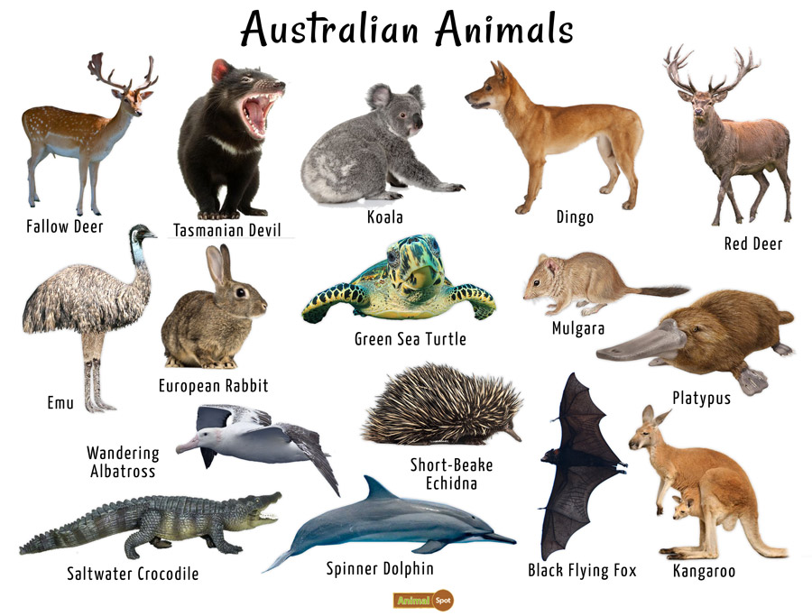

Slide 4




Link to 12 Best Cities in Australia

Slide 5
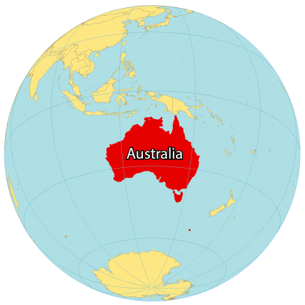
December 5-9
SS6CG4
Explain forms of citizen participation in government.
a. Explain citizen participation in democratic governments [i.e. the role of citizens in choosing the leaders of Australia (parliamentary democracy)].

Slide 6
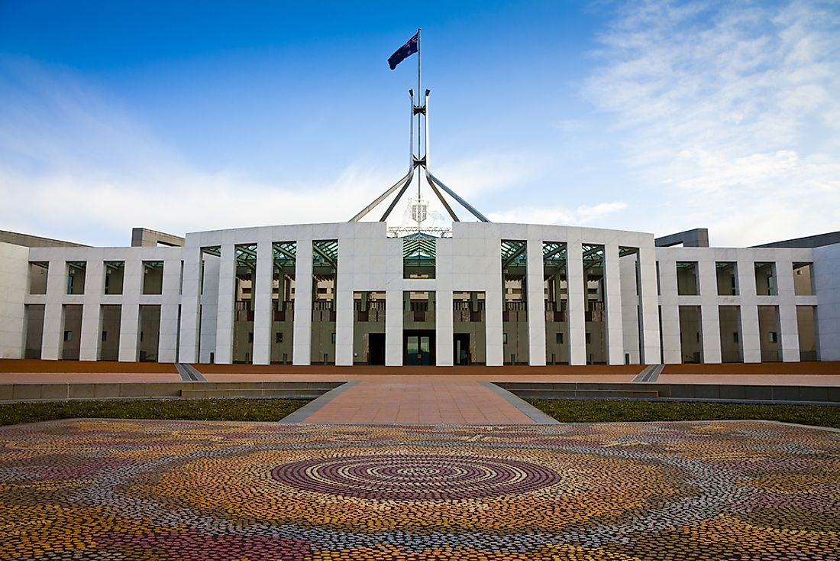

The Government of the Commonwealth of Australia is a federal democratic administrative authority of Australia. Australia’s system of government reflects both British and North American influences. Australia is governed by both the federal government and the state and territory governments. Queen Elizabeth II is Australia’s head of state under a constitutional monarchy. Australia is a member of the Commonwealth.

Slide 7
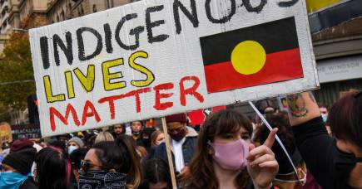
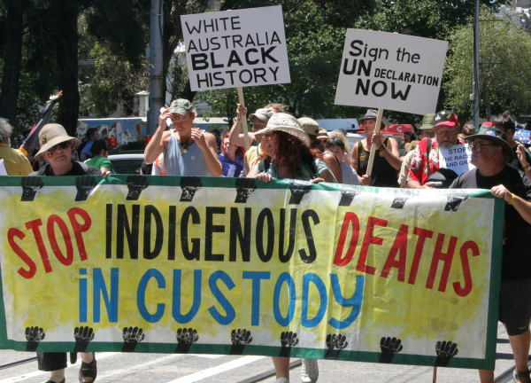
On Friday 3 April 2009 the Australian Government signed the Declaration on Rights for Indigenous Peoples at last. However aborigines have accused the Government of continued racism and hypocrisy regarding treatment of aborigines Australia-wide and particularly with the Northern Territory intervention

Slide 8
SS6H4
Explain the impact of English colonization on current Aboriginal basic rights, health, literacy, and language.

Slide 9
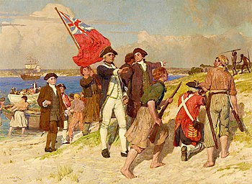

Slide 10
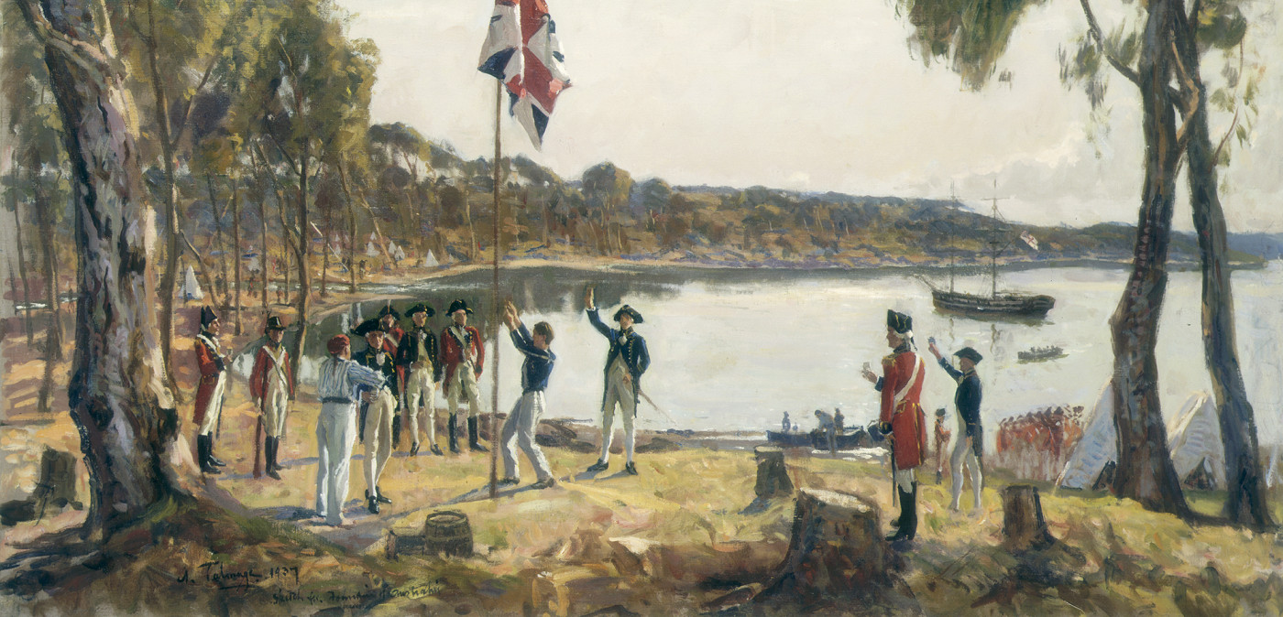

Slide 11
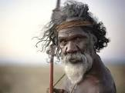
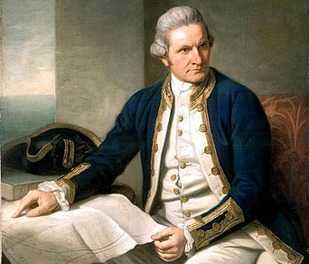
1788 – First Fleet and Convicts
The Dutch first sighted Australia in 1606 before Captain Cook colonized the land for Great Britain in 1770. The First Fleet of 11 boats arrived at Botany Bay in 1788 to establish New South Wales as a penal colony (receiving convicts until 1848). Convicts were later sent to the other states, with the exception of South Australia, which was established as a free colony in 1836.
Over 162,000 convicts were transported to Australia from Great Britain, the majority to New South Wales and Tasmania
First Nations Australian Origins
Indigenous Australians have lived in the nation for at least 50,000 years. This means they have the oldest living cultural history in the world. When the British arrived in 1788, as many as 250 different languages were spoken across the nation. Prior to the colonization of the British, there were between 300,000 and one million First Nations people living in Australia.

Slide 12
SS6G11 Locate selected features of Australia.
a. Locate on a world and regional political-physical map:
the Great Barrier Reef, Coral Sea, Uluru/Ayers Rock, Indian and Pacific Oceans, Great Dividing Range, and Great Victoria Desert.
SS6G12 Explain the impact of location, climate, distribution of natural resources, and population distribution on Australia.
a. Describe how Australia’s location, climate, and natural resources impact trade and affect where people live.

Slide 13
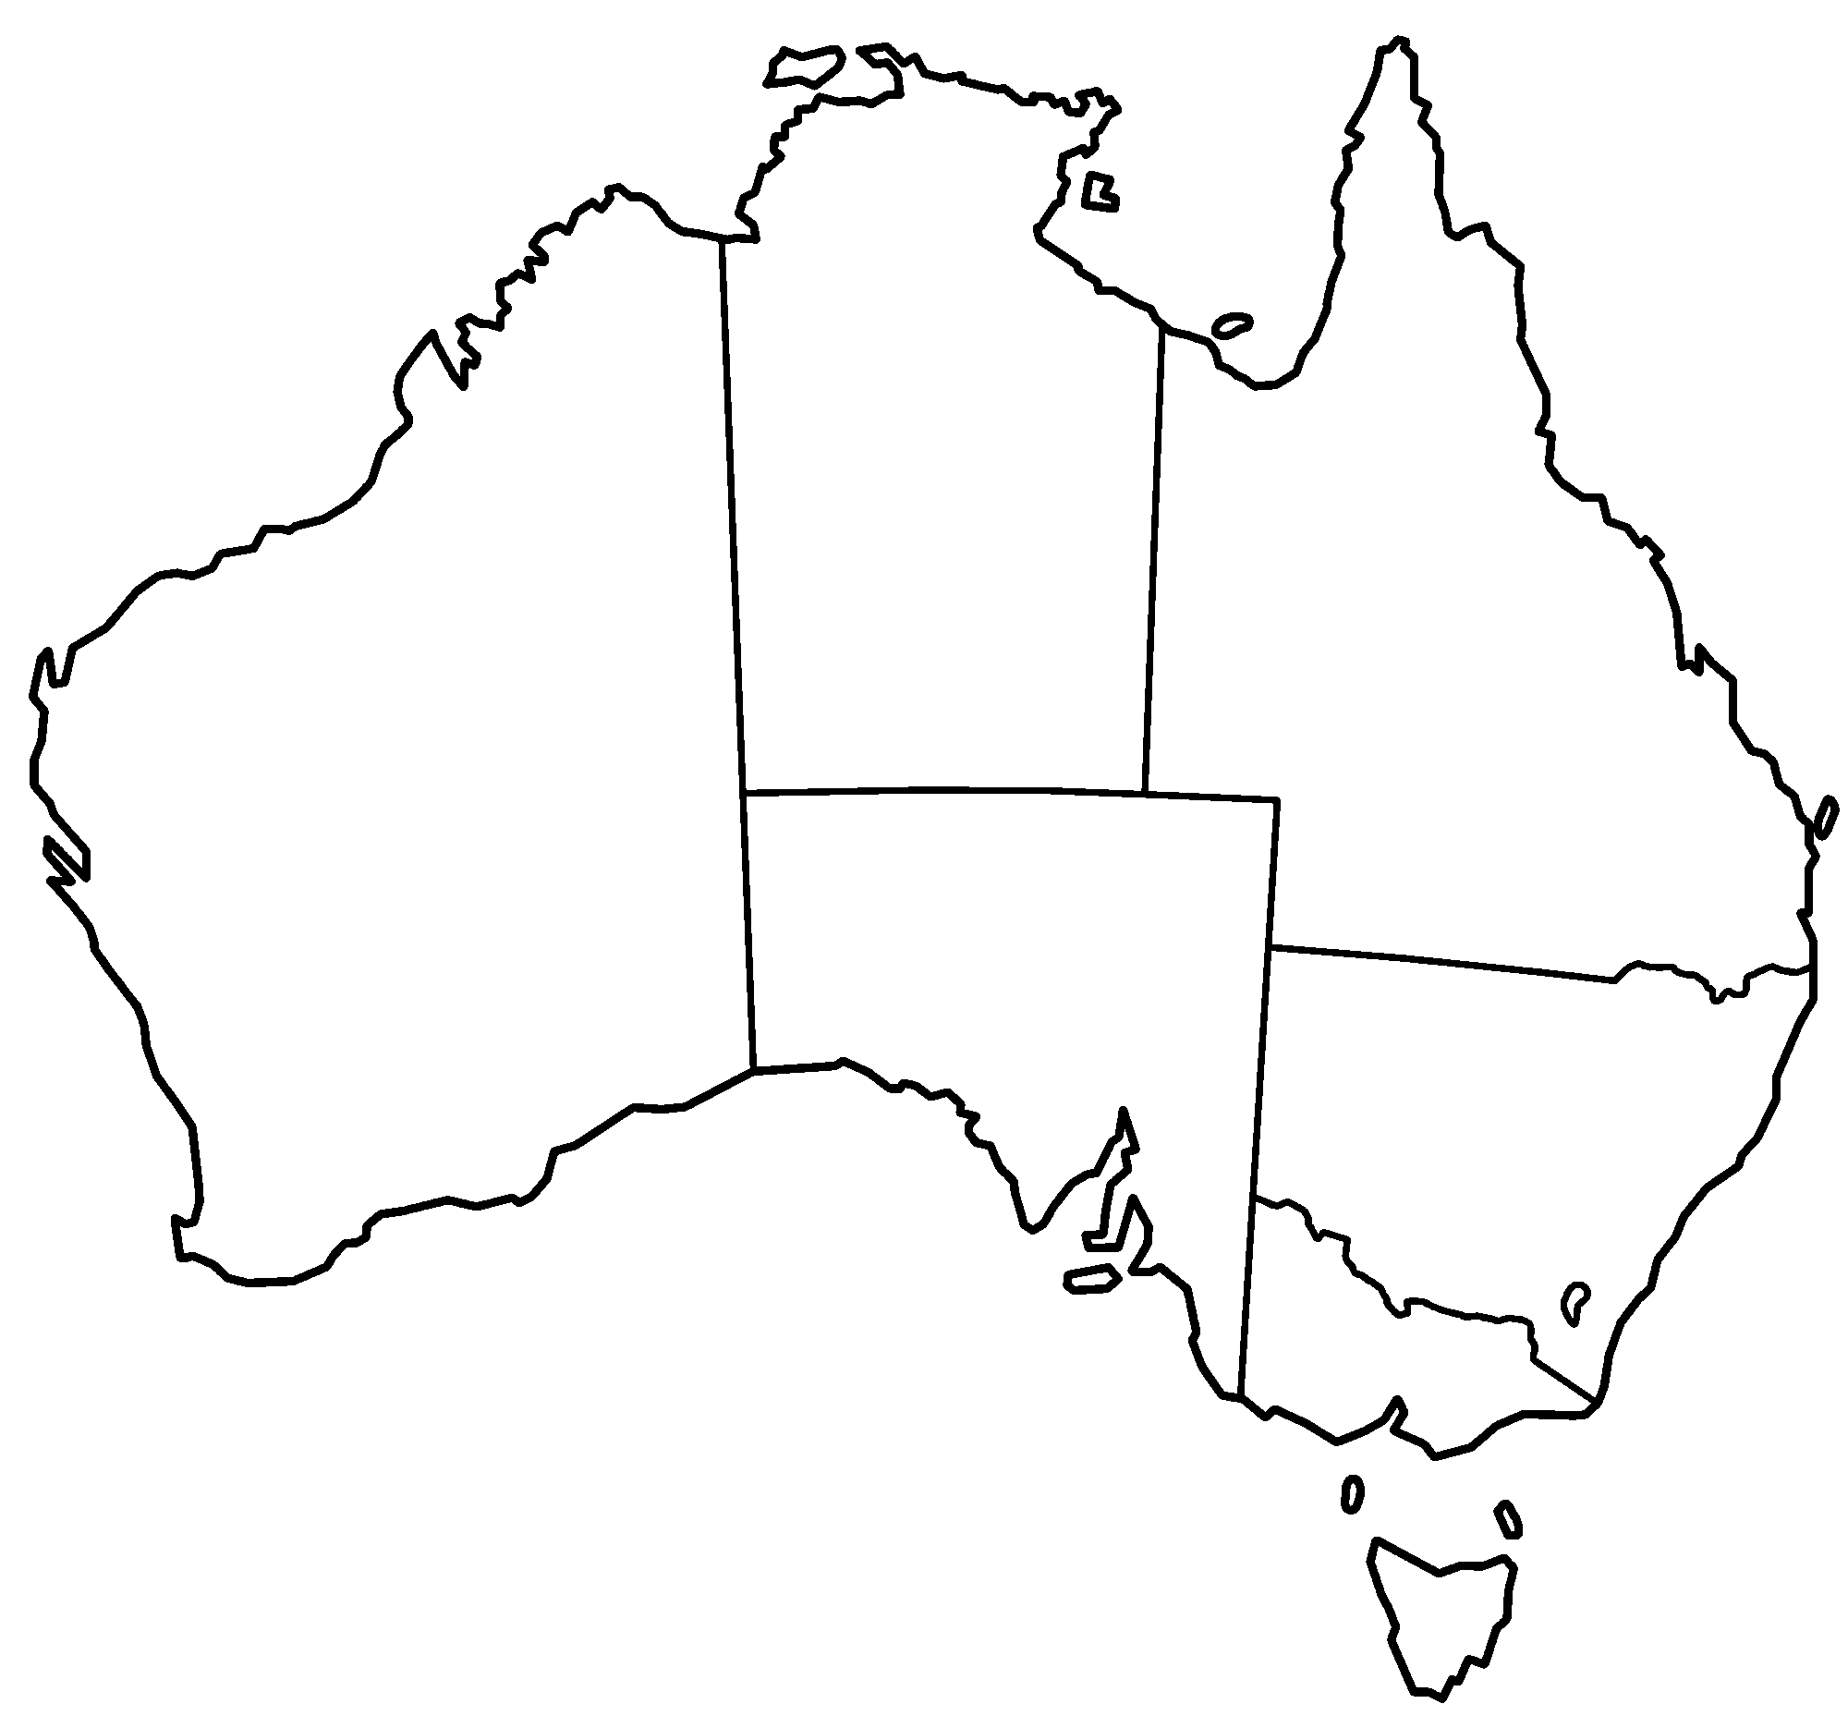

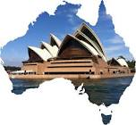
A
B
C
Northern Territory
D
Queensland
Western Australia
E
G
F
Southern Australia
New South Wales
B
Victoria
Indian Ocean (A)
Indian Ocean (B)
Coral Sea (C)
Great Barrier Reef (D)
Great Dividing Range (E)
Great Victoria Desert (F)
Uluru/Ayers Rock (G)
A
Tasmania
Land or water feature

Slide 14
Parents can use this map to quiz your child

Slide 15
A
B
C
Northern Territory
D
Queensland
Western Australia
E
G
F
Southern Australia
New South Wales
B
Victoria
A
Tasmania
Land or water feature

Slide 16
Monday, December 5
Standard: SS6CG4 a. Explain citizen participation in democratic governments [i.e. the role of citizens in choosing the leaders of Australia (parliamentary democracy)].
Learning Target: I can explain how citizens participate in democratic governments.
Warm-up: Chapter Review Notes (Textbook)
Work Session: Brain Wrinkles Slides and Notes; Textbook Ch.11 Section 3; Create Powerpoint Study Guide. SS WB p.115-125
Closing: TOD
Reminders:

Slide 17

Only 58% of Indigenous Australians are registered to vote. We should be asking why
Video Link-
What you need to know before casting a ballot | Federal Election | 9 News Australia
4:55 / 23:32
How the Australian Government Works | AUSPOL EXPLAINED
Link to Video

Slide 18
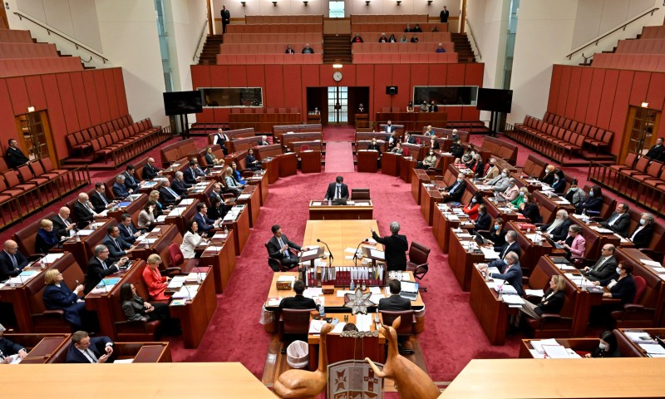
Read more about Australia Government
Link to Article
https://en.wikipedia.org/wiki/Australian_Government

Slide 19
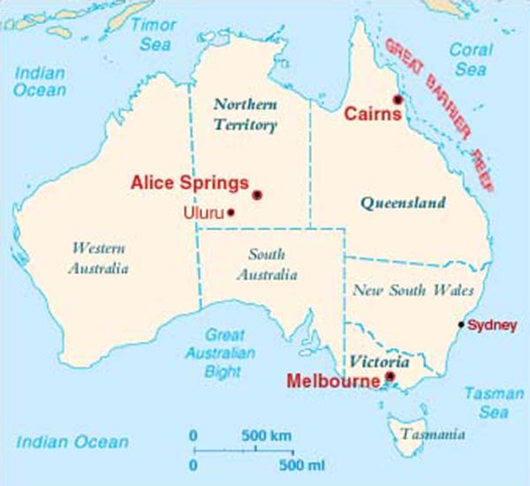

Slide 20
Tuesday, December 6
Standard: SS6CG4 a. Explain citizen participation in democratic governments [i.e. the role of citizens in choosing the leaders of Australia (parliamentary democracy)].
Learning Target: I can explain how citizens participate in democratic governments.
Warm-up: Australia Map
Work Session: Brain Wrinkles Slides and Notes; Textbook Ch.11 Section 3; Create Powerpoint Study Guide. SS WB p.115-125
Closing: Think-pair-Share
Reminders:

Slide 21
parliamentary system, democratic form of government in which the party (or a coalition of parties) with the greatest representation in the parliament(legislature) forms the government, its leader becoming prime minister orchancellor. Executive functions are exercised by members of the parliament appointed by the prime minister to thecabinet. The parties in the minority serve in opposition to the majority and have the duty to challenge it regularly. Prime ministers may be removed from power whenever they lose the confidence of a majority of the ruling party or of the parliament. The parliamentary system originated in Britain (see Parliament) and was adopted in several of its former colonies.

Slide 22
Wednesday, December 7
Standard: SS6CG4 a. Explain citizen participation in democratic governments [i.e. the role of citizens in choosing the leaders of Australia (parliamentary democracy)].
Learning Target: I can explain how citizens participate in democratic governments.
Warm-up: Australia Government Packet
Work Session: Brain Wrinkles Slides and Notes; Textbook Ch.11 Section 3; Create Powerpoint Study Guide. SS WB p.115-125
Closing: Three Important Things to Remember
Reminders:

Slide 23
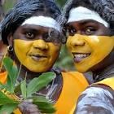

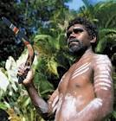
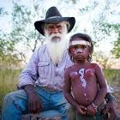

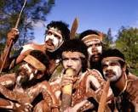

Slide 24
Australia’s first people—known as Aboriginal Australians—have lived on the continent for over 50,000 years. Today, there are 250 distinct language groups spread throughout Australia. Aboriginal Australians are split into two groups: Aboriginal peoples, who are related to those who already inhabited Australia when Britain began colonizing the island in 1788, and Torres Strait Islander peoples, who descend from residents of the Torres Strait Islands, a group of islands that is part of modern-day Queensland, Australia.

Slide 25
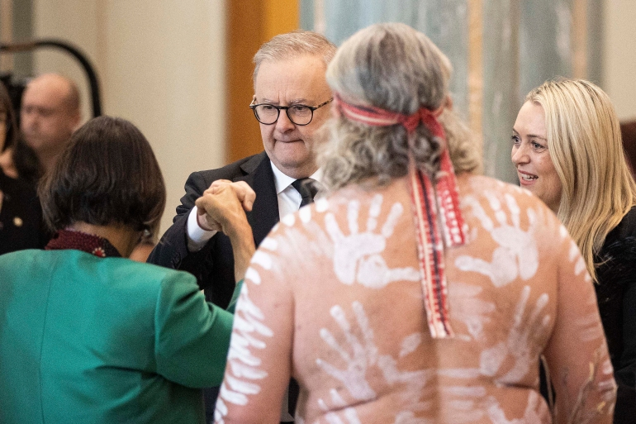
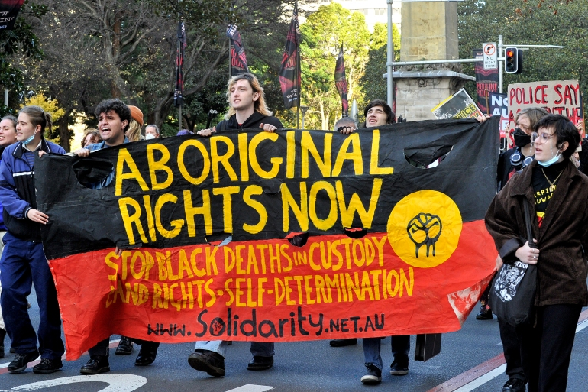

Slide 26
Thursday, December 8
Standard: SS6CG4 a. Explain citizen participation in democratic governments [i.e. the role of citizens in choosing the leaders of Australia (parliamentary democracy)].
Learning Target: I can explain how citizens participate in democratic governments.
Warm-up: Video: Australia
Work Session: Create Powerpoint Study Guide.
Closing: Think-pair-Share
Reminders:

Slide 27



Current Ministry List
Link to Ministry List

Slide 28
Friday, December 9
Standard: SS6CG4 a. Explain citizen participation in democratic governments [i.e. the role of citizens in choosing the leaders of Australia (parliamentary democracy)].
Learning Target: I can explain how citizens participate in democratic governments.
Warm-up: Powerpoint Study Guide
Work Session: Create Powerpoint Study Guide.
Closing: Three Important Things to Remember
Reminders:

Slide 29
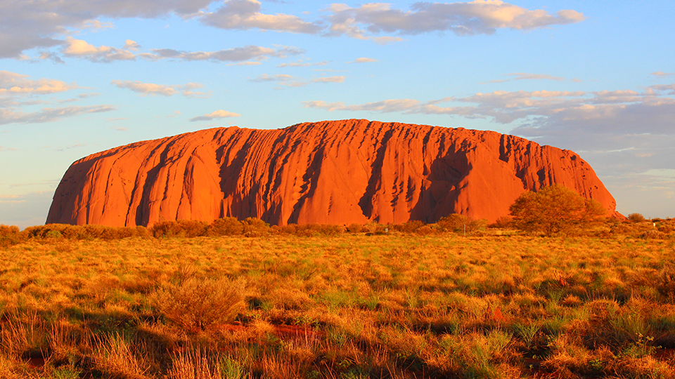
Uluru/Ayers Rock

Slide 30
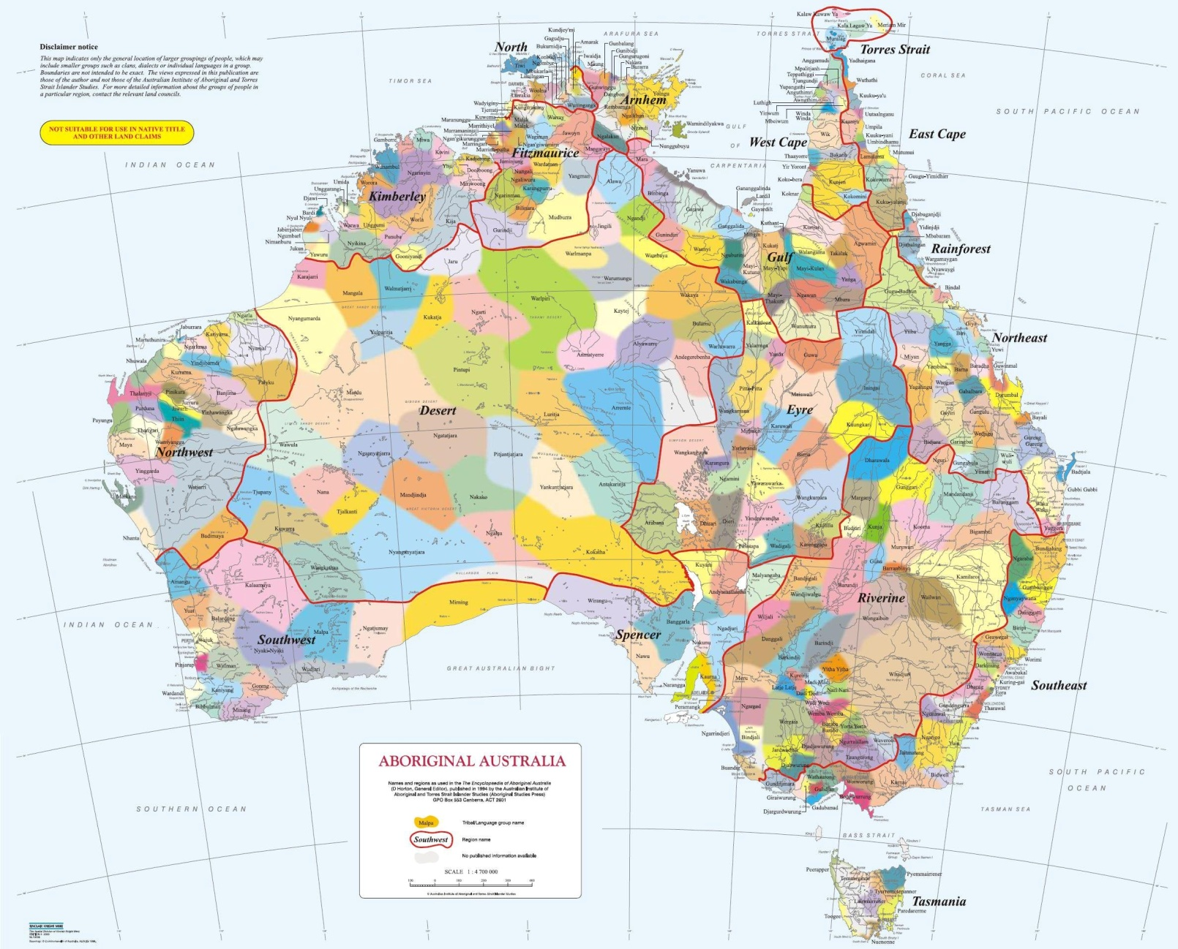
https://external-preview.redd.it/ckrO5dH3bwKW9yEGnPiiUtrqFIBPoEbPwwqOk4s2pcE.jpg?auto=webp&s=108b232de1e5696558ae5772fba3e813a4048068

Slide 31
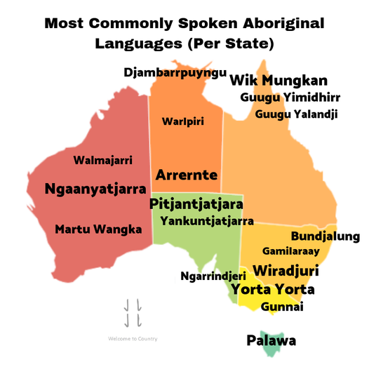

Slide 32
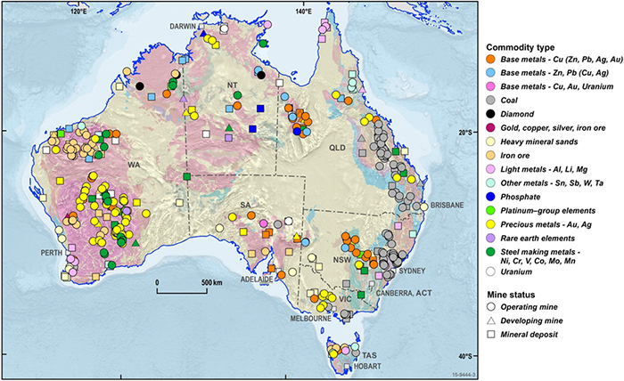
Australia is one of the world's leading producers of bauxite (aluminium ore), iron ore, lithium, gold, lead, diamond, rare earth elements, uranium, and zinc. Australia also has large mineral sand deposits of ilmenite, zircon and rutile.

Slide 33
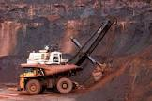
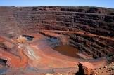
Western Australia Iron Ore (WAIO) is an integrated system of four processing hubs and five mines connected by more than 1,000 kilometres of rail infrastructure and port facilities in the Pilbara region of northern Western Australia

Slide 34
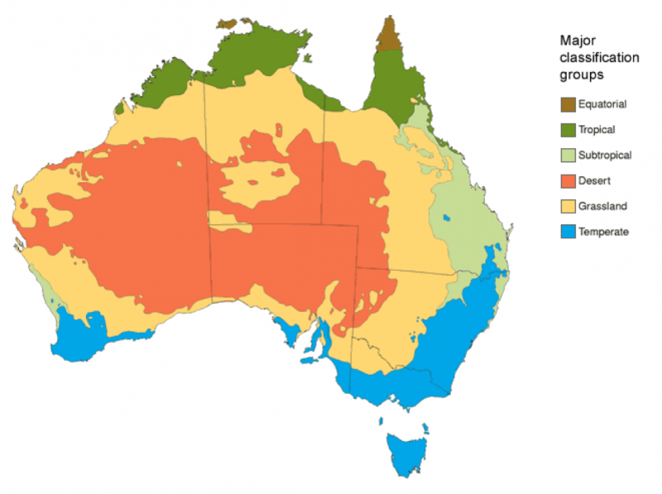
Climate

Slide 35
Historical Understandings
SS6H4 Explain the impact of English colonization on current Aboriginal basic rights, health, literacy, and language.
Geographic Understandings
SS6G11 Locate selected features of Australia.
a. Locate on a world and regional political-physical map: the Great Barrier Reef, Coral Sea, Uluru/Ayers Rock, Indian and Pacific Oceans, Great Dividing Range, and Great Victoria Desert.
SS6G12 Explain the impact of location, climate, distribution of natural resources, and population distribution on Australia.
a. Describe how Australia’s location, climate, and natural resources impact trade and affect where people live.

Slide 36
Australia
Historical Understandings
SS6H4 Explain the impact of English colonization on current Aboriginal basic rights, health, literacy, and language.
Geographic Understandings
SS6G11 Locate selected features of Australia.
a. Locate on a world and regional political-physical map: the Great Barrier Reef, Coral Sea, Uluru/Ayers Rock, Indian and Pacific Oceans, Great Dividing Range, and Great Victoria Desert.
SS6G12 Explain the impact of location, climate, distribution of natural resources, and population distribution on Australia.
a. Describe how Australia’s location, climate, and natural resources impact trade and affect where people live.
Government/Civic Understandings
SS6CG4 Explain forms of citizen participation in government.
a. Explain citizen participation in democratic governments [i.e. the role of citizens in choosing the leaders of Australia (parliamentary democracy)].

Slide 37
Economic Understandings
SS6E10 Analyze different economic systems.
a. Compare how traditional, command, and market economies answer the economic questions of 1-what to produce, 2-how to produce, and 3-for whom to produce.
b. Explain that countries have a mixed economic system located on a continuum between pure market and pure command.
c. Describe the economic system used in Australia.
SS6E11 Give examples of how voluntary trade benefits buyers and sellers in Australia.
a. Explain how specialization makes trade possible between countries.
b. Compare and contrast different types of trade barriers, such as tariffs, quotas, and embargoes.
c. Explain why international trade requires a system for exchanging currency between nations.
SS6E12 Describe factors that influence economic growth and examine their presence or absence in Australia.
a. Evaluate how literacy rates affect the standard of living.
b. Explain the relationship between investment in human capital (education and training) and gross domestic product (GDP per capita).
c. Explain the relationship between investment in capital goods (factories, machinery, and technology) and gross domestic product (GDP per capita).
d. Describe the role of natural resources in a country’s economy.
e. Describe the role of entrepreneurship.
SS6E13 Understand that a basic principle of effective personal money management is to live within one’s income.
a. Understand that income is received from work and is limited.
b. Understand that a budget is a tool to plan the spending and saving of income.
c. Understand the reasons and benefits of saving.
d. Understand the uses and costs of credit.

